Slide 1


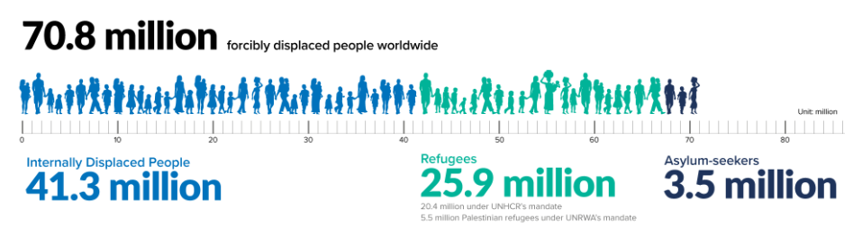
https://www.independent.co.uk/topic/refugee
https://www.unhcr.org/uk/figures-at-a-glance.html
Background
Intro
EEG
MINI
EEG+MINI
Structure
Takeaway
Future
Guidance
Notes:
Recently, refugee crisis is increasing day by day. According to UN, there are 71 million forcibly displaced people worldwide

Slide 2

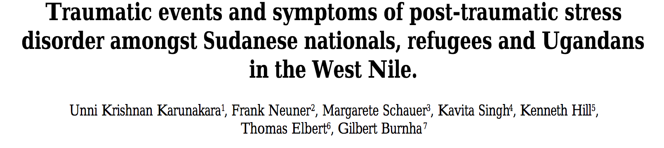
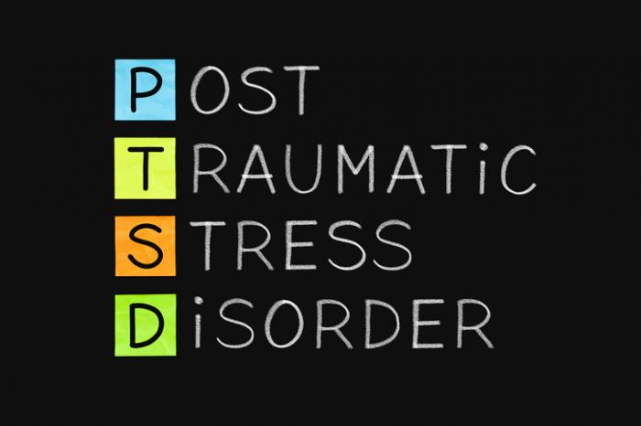

Background
Intro
EEG
MINI
EEG+MINI
Structure
Recommendation
Future
Guidance
Notes:
The refugees have gone through repeated trauma and previous research shows that such repeated exposure causes PTSD, Post-traumatic stress disorder.
The refugee population does not have access to a hospital, let alone mental health specialist.

Slide 3

Mental Health Care Scarcity
Karunakara, Unni Krishnan, et al. "Traumatic events and symptoms of post-traumatic stress disorder amongst Sudanese nationals, refugees and Ugandans in the West Nile." African health sciences 4.2 (2004): 83-93.
Background
Intro
EEG
MINI
EEG+MINI
Structure
Takeaway
Future
Guidance
Notes:
The refugees have gone through repeated trauma and previous research shows that such repeated exposure causes PTSD, Post-traumatic stress disorder.
The refugee population does not have access to a hospital, let alone mental health specialist.

Slide 4
Standard Treatment
Background
Intro
EEG
MINI
EEG+MINI
Structure
Takeaway
Future
Guidance
Notes:
In advanced countries, the treatment is done by detailed mental health evaluation by specialist

Slide 5
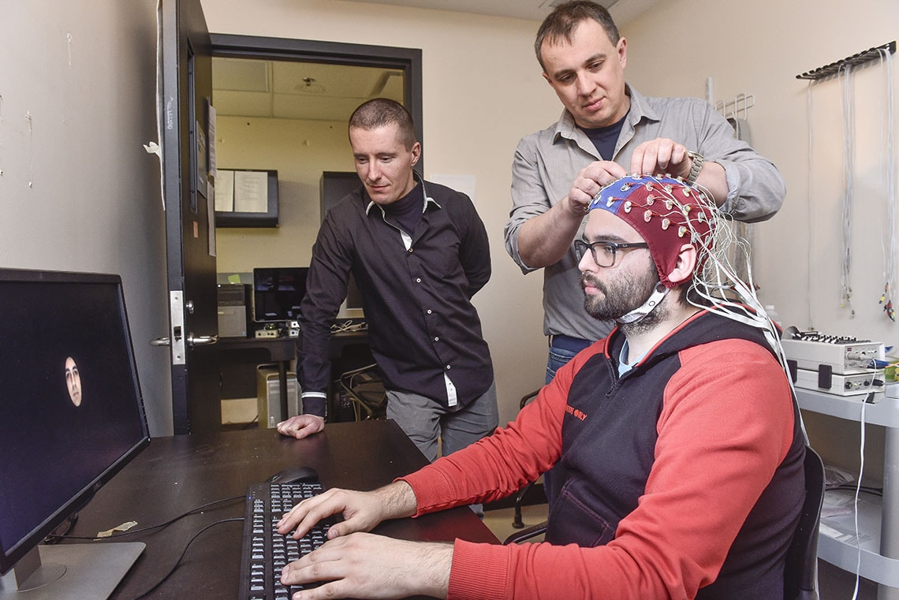
Research Frontier: Electroencephalogram (EEG)
Background
Intro
EEG
MINI
EEG+MINI
Structure
Takeaway
Future
Guidance
Notes:
Recently, research has been done to to use EEG signals to measure PTSD related signals

Slide 6

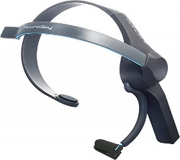
Research Question
Can we improve access to PTSD screening with a low cost, fast and flexible automated wearable system?
Resources
The MINI Questionnaire
$112 NeuroSky Mindwave
Background
Intro
EEG
MINI
EEG+MINI
Structure
Takeaway
Future
Guidance

Slide 7

https://www.robertsonburns.com/how-we-are-different/
Background
Intro
EEG
MINI
EEG+MINI
Recommendation
Future
Guidance
7
Structure
7
Notes:
So, How are we doing something different here?

Slide 8





https://www.medicalnewstoday.com/articles/316698.php
https://corporateleaderscommunications.com/blog/marketing-operations-2-0-defining-the-new-organizational-structure/
http://clipartsign.com/image/12020/
https://www.zdnet.com/article/faster-flexible-forward-looking-how-to-make-it-more-responsive-to-business/
https://cloudlibrariandownunder.wordpress.com/2016/09/02/speedy-coding-and-discovery-how-fast-is-fast-and-making-a-difference-for-library-users/
Background
Intro
EEG
MINI
EEG+MINI
Recommendation
Future
Guidance
8
Structure
8
Notes:
Refuges situation Pic-1: scarce resource, lack of organization, lack of hospital.
Pic-2: a simple questionnaire, portable, cheap, consumer-grade headset. Pic-3: Flexible, less money, fast

Slide 9





Two Tell-tale Perspectives of PTSD: Neurobiological Abnormalities and Bayesian Regulatory Network of the Underlying Disorder in a Refugee Context
Wasifur Rahman
Farhana Shahid, , Anika Binte Islam, Nipi Paul, Nabila Khan, Mohammad Saifur Rahman, Md Munirul Haque, and A. B. M. Alim Al Islam
Background
Intro
EEG
MINI
EEG+MINI
Recommendation
Future
Guidance
9
Structure
9
9
Notes:
On behalf of my co-authors, I am Wasifur Rahman, representing ROC-HCI lab of the University of Rochester

Slide 10
Two Tell-tale Perspectives of PTSD: Neurobiological Abnormalities and Bayesian Regulatory Network of the Underlying Disorder in a Refugee Context
Wasifur Rahman
Farhana Shahid, , Anika Binte Islam, Nipi Paul, Nabila Khan, Mohammad Saifur Rahman, Md Munirul Haque, and A. B. M. Alim Al Islam
Background
Intro
EEG
MINI
EEG+MINI
Structure
Takeaway
Future
Guidance
Notes:
On behalf of my co-authors, I am Wasifur Rahman, representing ROC-HCI lab of the University of Rochester

Slide 11




https://www.medicalnewstoday.com/articles/316698.php
https://corporateleaderscommunications.com/blog/marketing-operations-2-0-defining-the-new-organizational-structure/
http://clipartsign.com/image/12020/
https://remote.co/why-the-future-of-work-is-remote/
Background
Intro
EEG
MINI
EEG+MINI
Recommendation
Future
Guidance
Structure
11
Notes:
We want to diagnosis and organization of ptsd and its symptoms. Also we want to hypothise design choices in such cases and possible future direction

Slide 12
Goals
Detecting Relevant EEG Signals
Bayesian Model
Validation
Future Work
Guidance
Background
Intro
EEG
MINI
EEG+MINI
Structure
Takeaway
Future
Guidance
Notes:
We want to diagnosis and organization of ptsd and its symptoms. Also we want to hypothise design choices in such cases and possible future direction

Slide 13
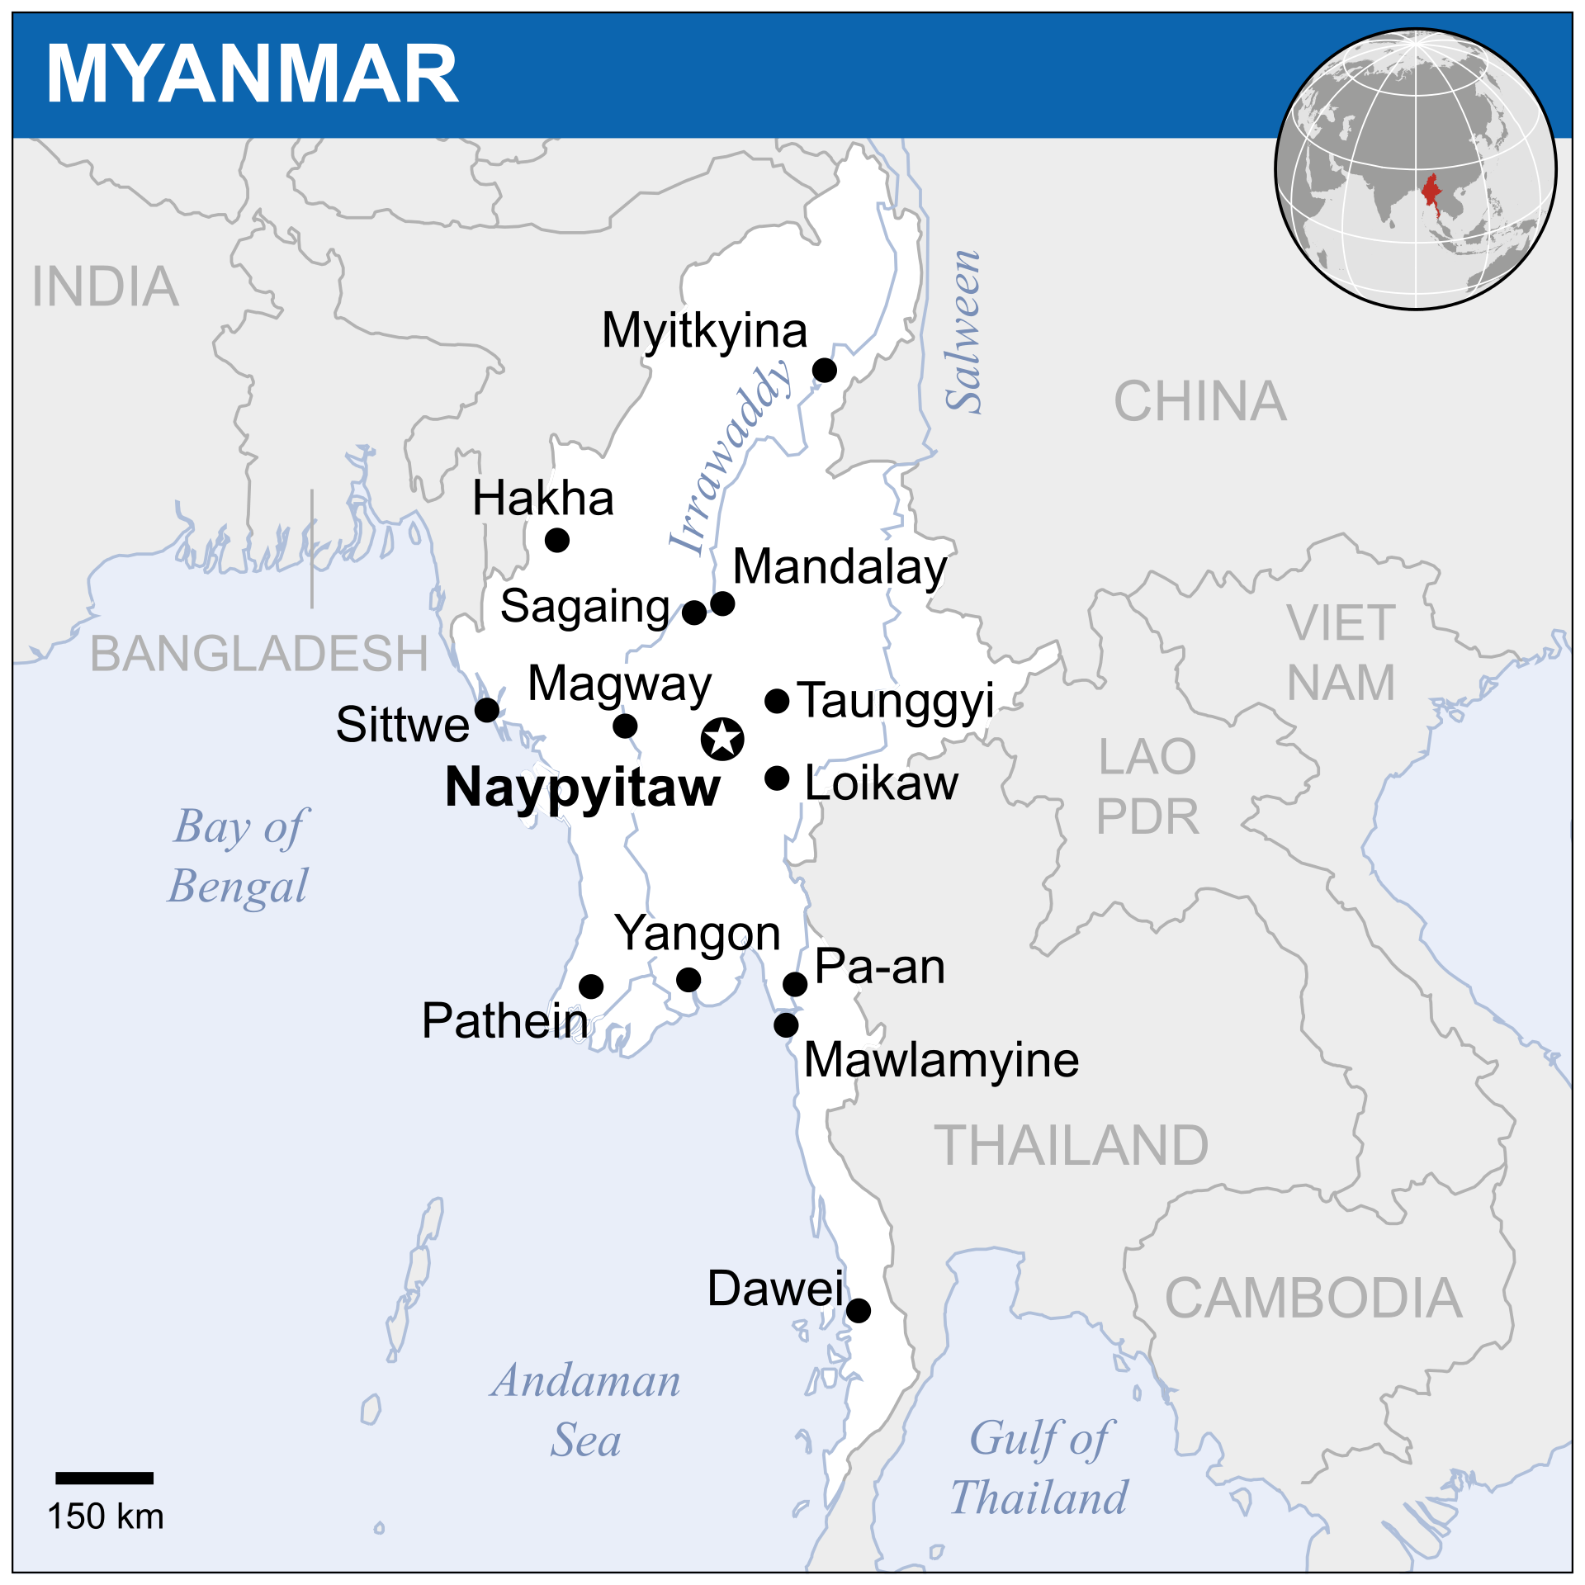



[2,3,4,5]
Background
Intro
EEG
EEG+MINI
Background
Intro
EEG
MINI
EEG+MINI
Structure
Recommendation
Future
Guidance
MINI
Recommendation
Future
Guidance
Structure
13
Notes:
1.The south-Asian country of Myanmar. 2.They are an ethnic minority there. 3.Denied citizenship 4. Repeated persecution according to Human-rights-watch:https://www.hrw.org/tag/rohingya-crisis

Slide 14
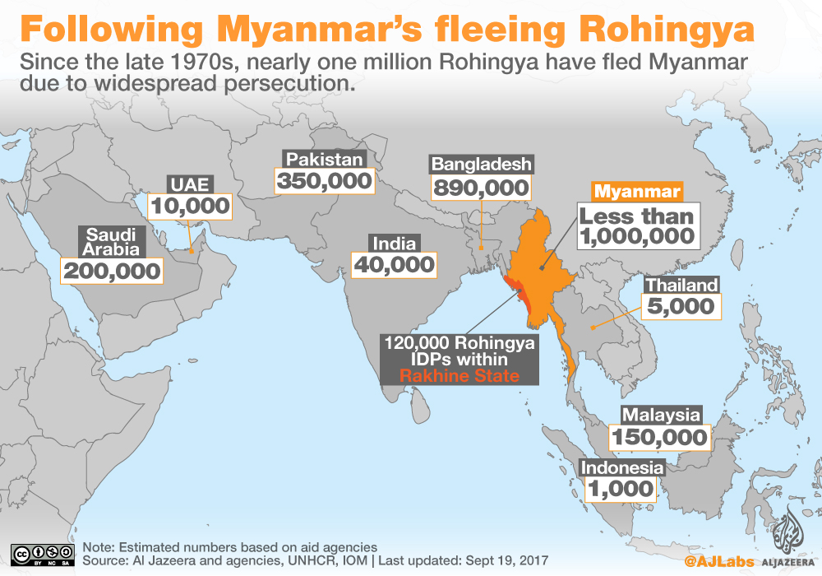

Refugee Population
[6]
Background
Intro
EEG
MINI
EEG+MINI
Structure
Takeaway
Future
Guidance
Notes:
As a result, more than a million have fled to other countries, especially to the neighbouring BD, where around close to 1 million of them live now.

Slide 15
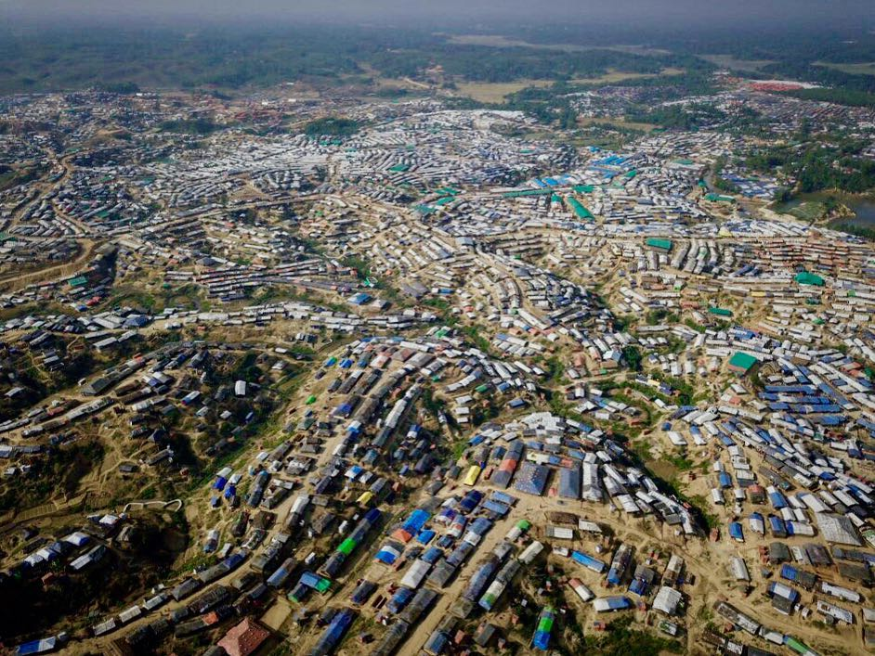
Refugee Camp
[7]
Background
Intro
EEG
MINI
EEG+MINI
Structure
Takeaway
Future
Guidance
Notes:
Many are in Kutupalong, the largest refugee camp in the world. Just a partial view of the camp

Slide 16

The United Nations has described the Rohingya “as the most persecuted minority in the world.”
https://www.unrefugees.org/emergencies/rohingya/
[1]
Background
Intro
EEG
MINI
EEG+MINI
Structure
Takeaway
Future
Guidance
Notes:
The Rohingya’s are the most persecuted minority in the world

Slide 17


https://www.justgiving.com/campaigns/charity/khalsaaid/refugees
http://www.adrianharris.org/wisdom.htm
Background
Intro
EEG
MINI
EEG+MINI
Recommendation
Future
Guidance
Structure
17
Notes:
Many organizations are doing the relief work, but we human beings need mental health support too.

Slide 18
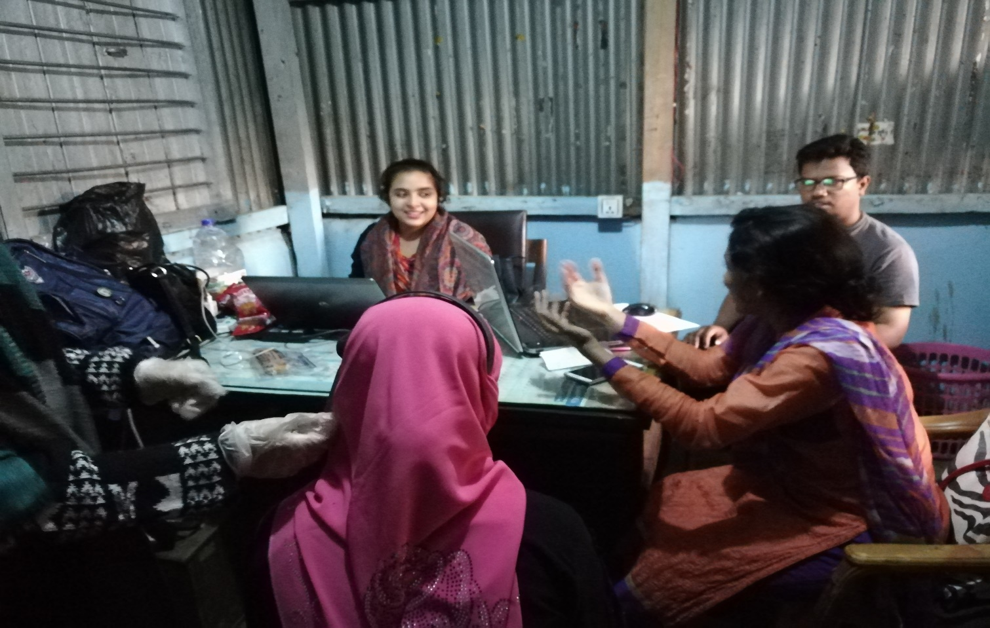
Interview
Interviewers
Interviewers
EEG headset
EEG headset
Participant
Participant
Data Collection in Rohingya Camp
Background
Intro
EEG
MINI
EEG+MINI
Structure
Takeaway
Future
Guidance
Notes:
And we went to kutupalang refugee camp to collect data

Slide 19
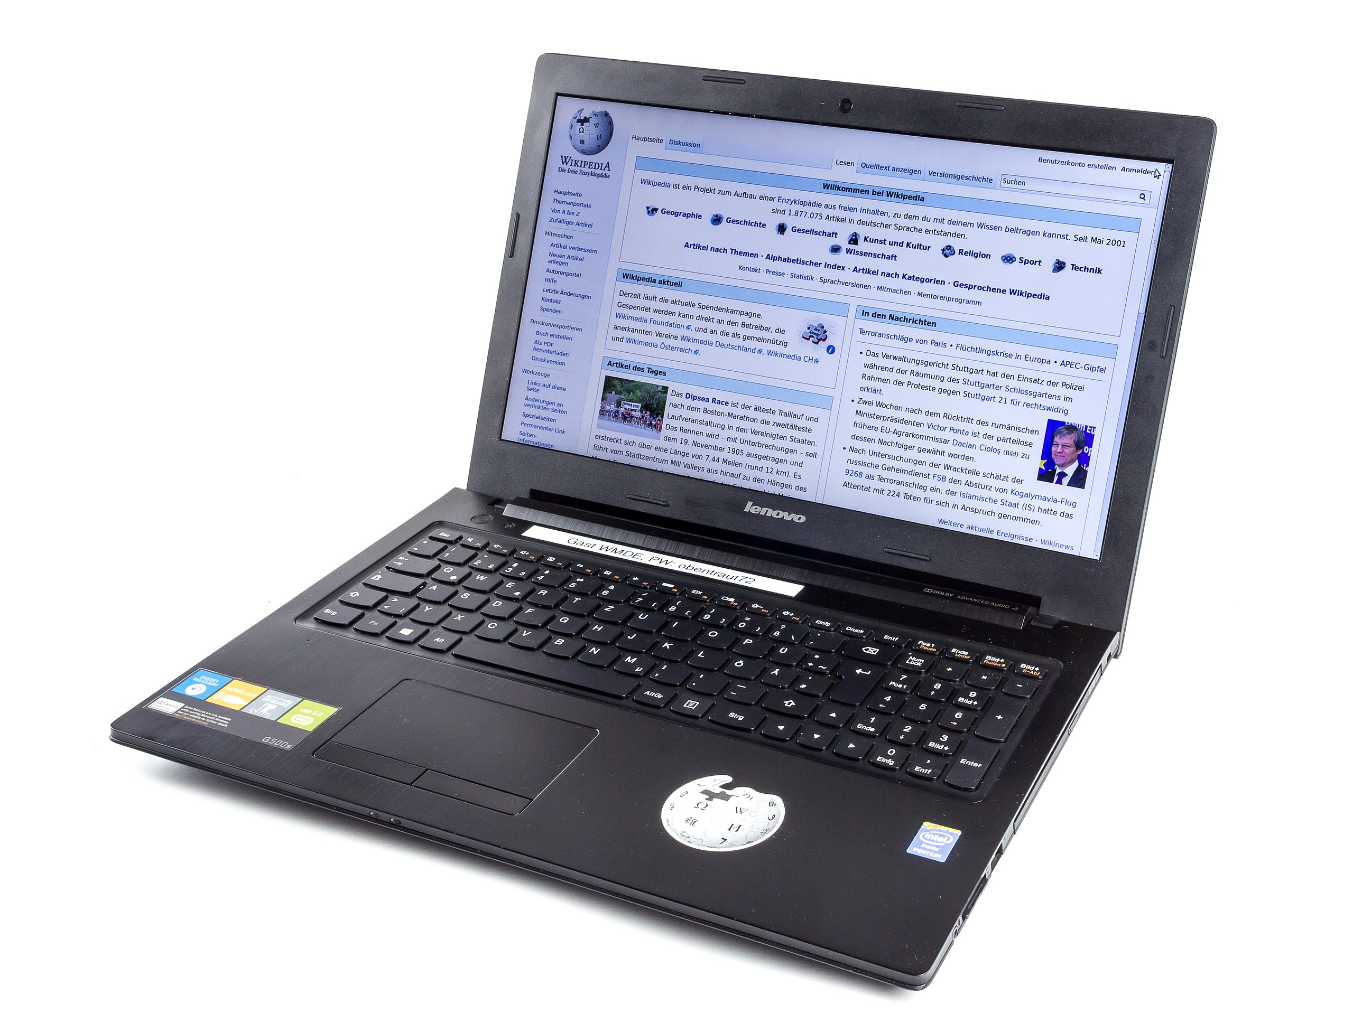
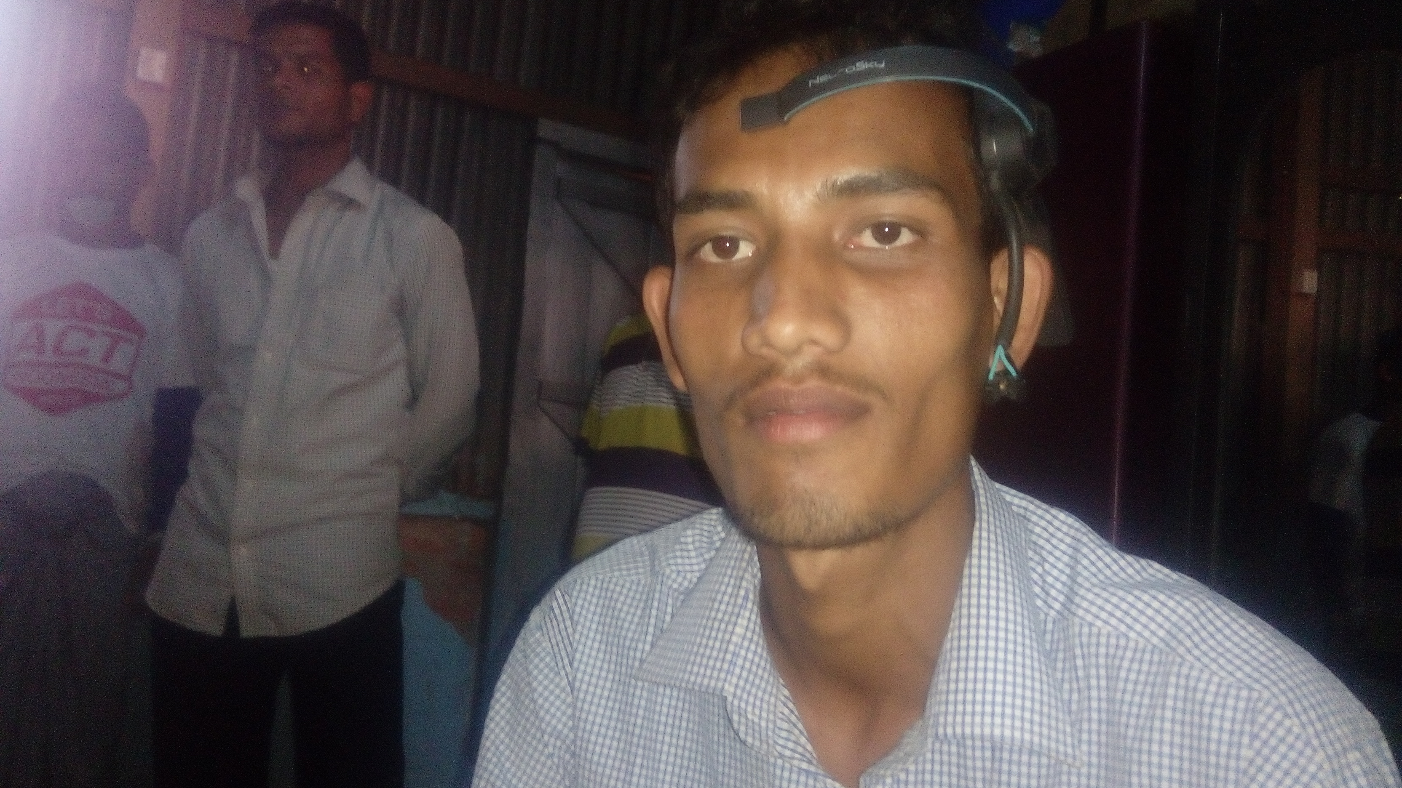

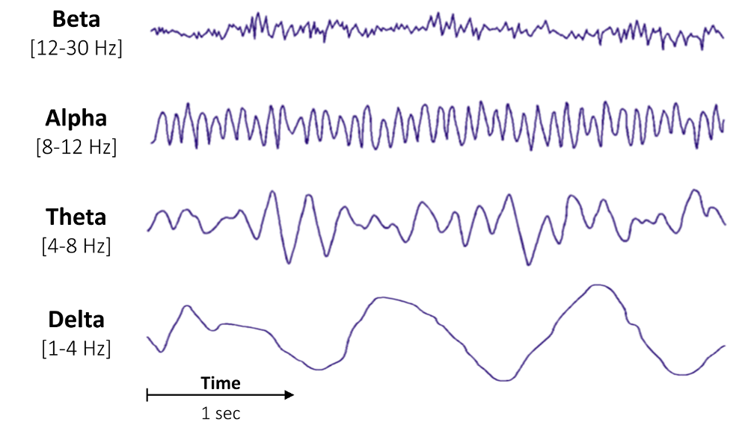
EEG Data Collection
https://en.wikipedia.org/wiki/Laptop#/media/File:Lenovo_G500s_laptop-2905.jpg
https://raphaelvallat.com/bandpower.html
Background
Intro
EEG
MINI
EEG+MINI
Structure
Takeaway
Future
Guidance
Notes:
EEG-Headset, through Bluetooth to the laptop, then 4 EEG signals

Slide 20





Mini-International Neuropsychiatric Interview (MINI)
PTSD Module
Q4: Do you have trouble recalling exactly what had happened?
in Q4 or 2/5 Qs
PTSD
https://www.dreamstime.com/royalty-free-stock-photography-psychiatrist-male-patient-image18374737
https://moot.typepad.com/.a/6a00d8341c01ff53ef01b7c73e25c5970b-popup
Background
Intro
EEG
MINI
EEG+MINI
Recommendation
Future
Guidance
20
Structure
20
Notes:
We use the MINI form. Created by Psychriatist from US and Europe. Using the PTSD module only. It has 5 questions, each with binary yes or no. Q-4 is a very crucial one on trouble in remembering exactly what happened. If the subject answers yes in q5 or any of the 2/5 questions, he is declared to have PTSD

Slide 21
MINI Data Collection
The Mini-International Neuropsychiatric Interview (MINI)
Sheehan, David V., et al. "The Mini-International Neuropsychiatric Interview (MINI): the development and validation of a structured diagnostic psychiatric interview for DSM-IV and ICD-10." The Journal of clinical psychiatry (1998).
Compatible with both ICD-10 and DSM-V disorders
PTSD Module
Q4: Do you have trouble recalling exactly what had happened?
Probable PTSD
Background
Intro
EEG
MINI
EEG+MINI
Structure
Takeaway
Future
Guidance
Notes:
We use the MINI form. Created by Psychriatist from US and Europe. Using the PTSD module only. It has 5 questions, each with binary yes or no. Q-4 is a very crucial one on trouble in remembering exactly what happened. If the subject answers yes in q5 or any of the 2/5 questions, he is declared to have PTSD

Slide 22

Data Overview
#Control = 45
#PTSD refugee= 49
PTSD as defined by MINI
Feeling distressed
Nightmare
Avoiding trauma-related stimuli
Inability to recall key features of trauma
Difficulty in sleeping
Irritability
Difficulty in concentrating
Feeling nervous
Background
Intro
EEG
MINI
EEG+MINI
Structure
Takeaway
Future
Guidance
Notes:
From MINI, we get this 9 signals. From headset, we get this signals, so can we merge their results together?
?

Slide 23
Validation
 | Low Alpha | High Alpha | Low Beta | High Beta | Mid Gamma
PTSD
Distress
Nightmare
Avoidance
Recall Inability
Sleeping Difficulty
Irritability
Concentration Difficulty
Nervousness
Only showing entries with p <0.01 after Benjamini-Hochberg multiple test correction
Thissen D, Steinberg L, Kuang D. Quick and easy implementation of the Benjamini-Hochberg procedure for controlling the false positive rate in multiple comparisons. Journal of educational and behavioral statistics. 2002 Mar;27(1):77-83.
NeuroSky. 2015. Greek Alphabet Soup - Making Sense of EEG Bands. Retrieved September 14, 2018 from http://neurosky.com/2015/05/ greek-alphabet-soup-making-sense-of-eeg-bands/
Background
Intro
EEG
MINI
EEG+MINI
Structure
Takeaway
Future
Guidance
Notes:
The rows are the various symptoms. The columns are the signals. Note that the alpha signal has two components: Low and High. It is basically the higher and lower end of the alpha spectrum

Slide 24

Validation
 | Low Alpha | High Alpha | Low Beta | High Beta | Mid Gamma
PTSD
Distress
Nightmare
Avoidance
Recall Inability
Sleeping Difficulty
Irritability
Concentration Difficulty
Nervousness
Only showing entries with p <0.01 after Benjamini-Hochberg multiple test correction
Low Alpha
$$∼$$
Anxiety, High Stress, Insomnia
NeuroSky. 2015. Greek Alphabet Soup - Making Sense of EEG Bands. Retrieved September 14, 2018 from http://neurosky.com/2015/05/ greek-alphabet-soup-making-sense-of-eeg-bands/
Background
Intro
EEG
MINI
EEG+MINI
Structure
Takeaway
Future
Guidance
Notes:
Low alpha shows low value for PTSD, Distress, sleeping difficulty and nervousness. And it is consistent with the previous research.

Slide 25

Validation
 | Low Alpha | High Alpha | Low Beta | High Beta | Mid Gamma
PTSD
Distress
Nightmare
Avoidance
Recall Inability
Sleeping Difficulty
Irritability
Concentration Difficulty
Nervousness
Only showing entries with p <0.01 after Benjamini-Hochberg multiple test correction
$$∼$$
Lower Anxiety, Increased Calmness, Good Cognitive Memory
High Alpha
Baruch Rael Cahn and John Polich. 2006. Meditation states and traits: EEG, ERP, and neuroimaging studies. Psychological Bulletin 132, 2
(2006),180–211.
Wolfgang Klimesch. 1999. EEG alpha and theta oscillations reflect cognitive and memory performance: a review and analysis. Brain Research
Reviews29,2(1999),169–195
Background
Intro
EEG
MINI
EEG+MINI
Structure
Takeaway
Future
Guidance
Notes:
The same trend is there in the high alpha

Slide 26

Validation
 | Low Alpha | High Alpha | Low Beta | High Beta | Mid Gamma
PTSD
Distress
Nightmare
Avoidance
Recall Inability
Sleeping Difficulty
Irritability
Concentration Difficulty
Nervousness
Only showing entries with p <0.01 after Benjamini-Hochberg multiple test correction
$$∼$$
Low Beta
PTSD, Insomnia, Anxiety, Stress, Inattention, Memory-Promoting state
Dražen Begić, Ljubomir Hotujac, and Nataša Jokić-begić. 2001. Electroencephalographic comparison of veterans with combat-related post-traumaticstressdisorderandhealthysubjects.InternationalJournalofPsychophysiology40,2(2001),167–172.
Michael L. Perlis, Michael T. Smith, Patrick J. Andrews, Henry Orff, and Donna E. Giles. 2001. Beta/Gamma EEG Activity in Patients with PrimaryandSecondaryInsomniaandGoodSleeperControl NeuroSky. 2015. Greek Alphabet Soup - Making Sense of EEG Bands. Retrieved September 14, 2018 from http://neurosky.com/2015/05/ greek-alphabet-soup-making-sense-of-eeg-bands/
Background
Intro
EEG
MINI
EEG+MINI
Structure
Takeaway
Future
Guidance
Notes:
That is also true for low beta

Slide 27

Validation
 | Low Alpha | High Alpha | Low Beta | High Beta | Mid Gamma
PTSD
Distress
Nightmare
Avoidance
Recall Inability
Sleeping Difficulty
Irritability
Concentration Difficulty
Nervousness
Only showing entries with p <0.01 after Benjamini-Hochberg multiple test correction
$$∼$$
High Beta
Nervousness, Memory-Promoting state
Andreas K. Kaiser, Michael Doppelmayr, and Bernhard Iglseder. 2017. EEG beta 2 power as surrogate marker for memory impairment: a pilotstudy.InternationalPsychogeriatrics29,9(2017),1–9.
Leslie Sherlin, Fred Muench, and Sarah Wyckoff. 2010. Respiratory Sinus Arrhythmia Feedback in a Stressed Population Exposed to a Brief Stressor Demonstrated by Quantitative EEG and sLORETA. Applied Psychophysiology and Biofeedback 35, 3 (2010), 219–228
Background
Intro
EEG
MINI
EEG+MINI
Structure
Takeaway
Future
Guidance
Notes:
As well as high beta except in the case of nervousness which contradicts the previous research

Slide 28
 | Low Alpha | High Alpha | Low Beta | High Beta | Low gamma | Mid Gamma
PTSD
Distress
Nightmare
Avoidance
Recall Inability
Sleeping Difficulty
Irritability
Concentration Difficulty
Nervousness
Low gamma
$$∼$$
Attention deficiency,
Andreas K. Kaiser, Michael Doppelmayr, and Bernhard Iglseder. 2017. EEG beta 2 power as surrogate marker for memory impairment: a pilotstudy.InternationalPsychogeriatrics29,9(2017),1–9.
Leslie Sherlin, Fred Muench, and Sarah Wyckoff. 2010. Respiratory Sinus Arrhythmia Feedback in a Stressed Population Exposed to a Brief Stressor Demonstrated by Quantitative EEG and sLORETA. Applied Psychophysiology and Biofeedback 35, 3 (2010), 219–228
Notes:
Results with respect to positively tested

Slide 29

Validation
 | Low Alpha | High Alpha | Low Beta | High Beta | Mid Gamma
PTSD
Distress
Nightmare
Avoidance
Recall Inability
Sleeping Difficulty
Irritability
Concentration Difficulty
Nervousness
Only showing entries with p <0.01 after Benjamini-Hochberg multiple test correction
gamma
$$∼$$
Sleeping disturbances, attention deficiency
Andreas K. Kaiser, Michael Doppelmayr, and Bernhard Iglseder. 2017. EEG beta 2 power as surrogate marker for memory impairment: a pilotstudy.InternationalPsychogeriatrics29,9(2017),1–9.
Leslie Sherlin, Fred Muench, and Sarah Wyckoff. 2010. Respiratory Sinus Arrhythmia Feedback in a Stressed Population Exposed to a Brief Stressor Demonstrated by Quantitative EEG and sLORETA. Applied Psychophysiology and Biofeedback 35, 3 (2010), 219–228
Background
Intro
EEG
MINI
EEG+MINI
Structure
Takeaway
Future
Guidance
Notes:
The mid gamma shows variance for all symptoms and corroborates the previous research except in PTSD.

Slide 30
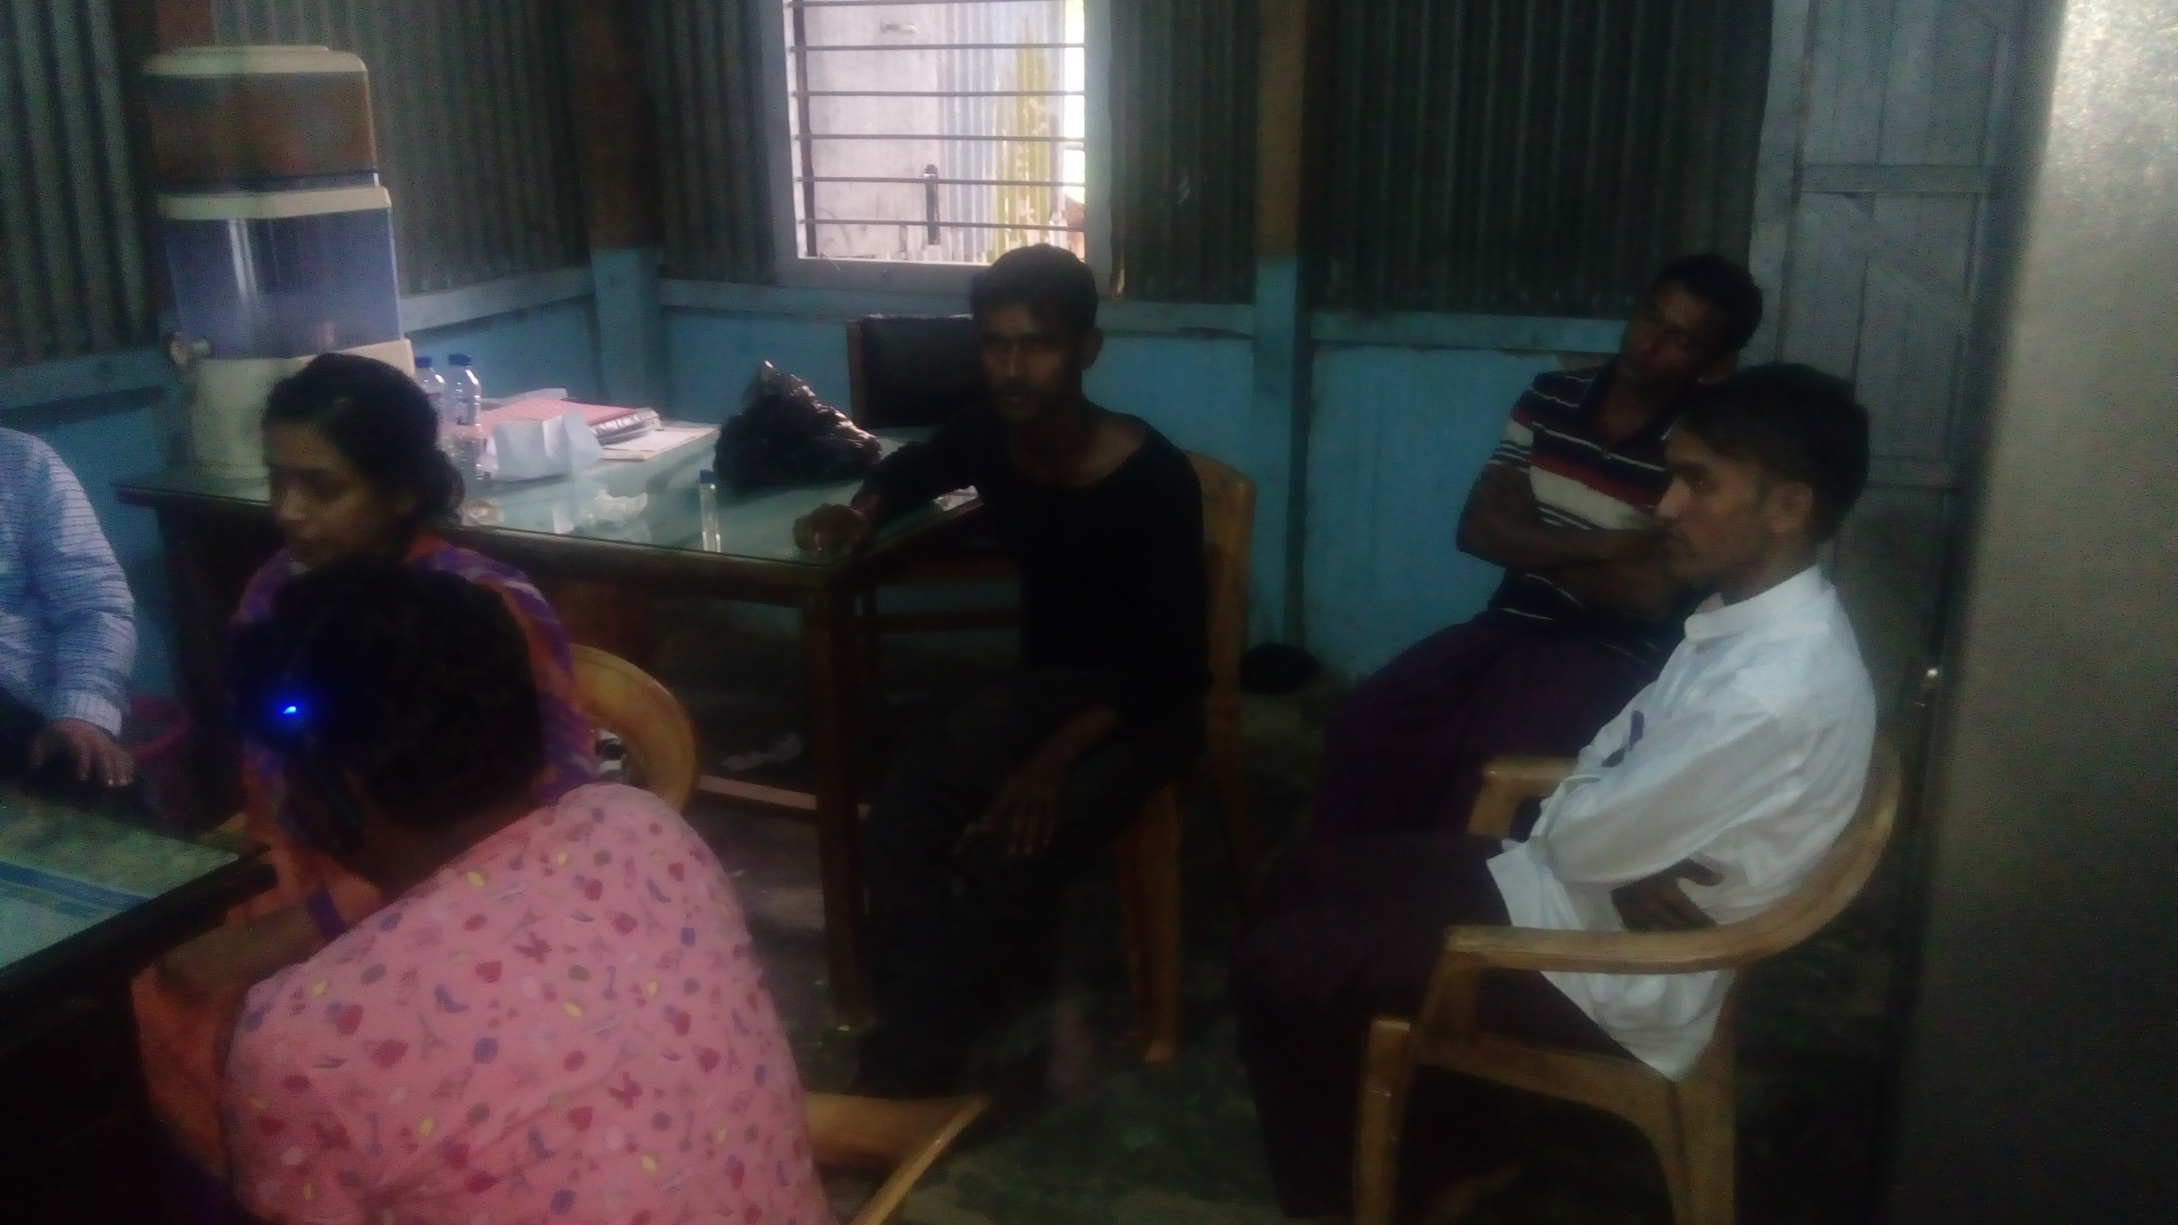
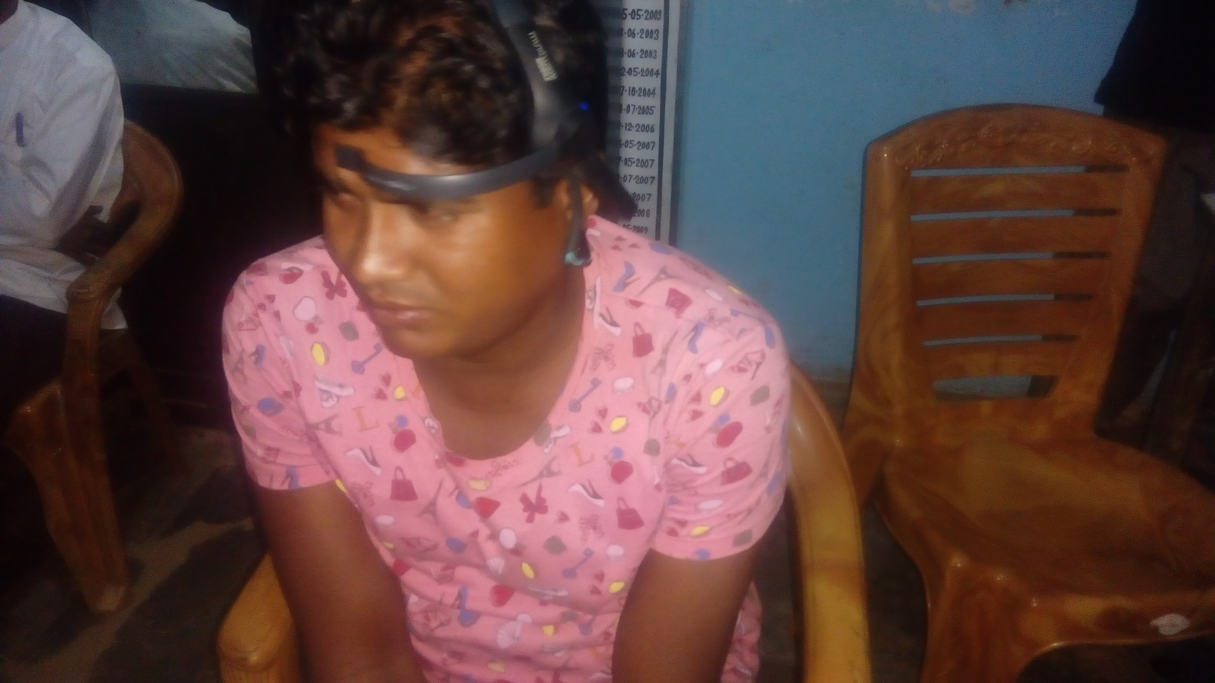
Why Contradiction?
https://www.utoronto.ca/news/new-technique-developed-u-t-uses-eeg-show-how-our-brains-perceive-faces
Background
Intro
EEG
MINI
EEG+MINI
Structure
Takeaway
Future
Guidance
Notes:
One key distinction is that eeg data is collected in a very controlled environment with very sophisticated machines. Ours was collected in a very real-life scenario with lots of people and noise going on around us

Slide 31
Background
Intro
EEG
MINI
EEG+MINI
Structure
Takeaway
Future
Guidance
Notes:
So, how about the structure of the PTSD

Slide 32
Bayesian Model
Avoidance
It does not show causation
PTSD
Sleeping Difficulty
Irritability
Nervousness
Nightmare
Recall Inability
Distress
Concentration Difficulty
Background
Intro
EEG
MINI
EEG+MINI
Structure
Takeaway
Future
Guidance
Notes:
As we can see, sleeping difficulty is the central point of this network, It has direct connection with two other symptoms and 1-degree separation with three others. It also has direct back-channel with PTSD as well as with Avoidance, the only direct parent of PTSD.

Slide 33

Take Home Message
Koffel, Erin, Imran S. Khawaja, and Anne Germain. "Sleep disturbances in posttraumatic stress disorder: updated review and implications for treatment." Psychiatric annals 46.3 (2016): 173-176.
Ulmer, Christi S., Jack D. Edinger, and Patrick S. Calhoun. "A multi-component cognitive-behavioral intervention for sleep disturbance in veterans with PTSD: a pilot study." Journal of Clinical Sleep Medicine 7.01 (2011): 57-68.
Vandrey, Ryan, et al. "Interactions between disordered sleep, post-traumatic stress disorder, and substance use disorders." International Review of Psychiatry 26.2 (2014): 237-247.
Background
Intro
EEG
MINI
EEG+MINI
Structure
Takeaway
Future
Guidance
Notes:
Solution approach: solve sleep disorder. It will have the greatest impact on the other symptoms. Neuro-biofeedback. Externally give signals to regulate the underlying signals

Slide 34
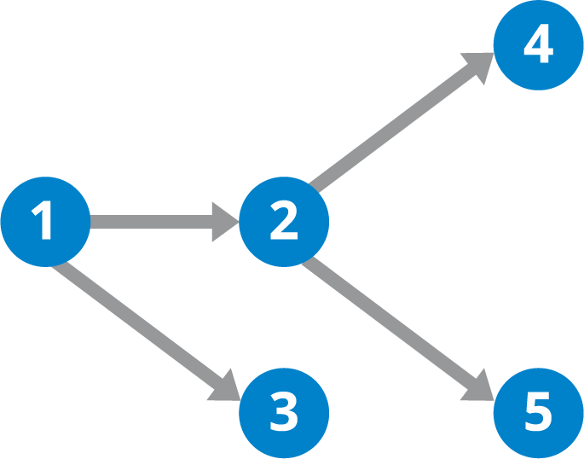
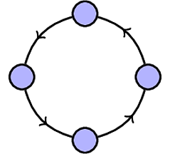


Future Works
Cyclic Structure
Better device
More-intuitive design
https://www.blastam.com/data-quality-assurance
https://steemit.com/bitcoin/@chitty/bitcoin-maximalists-are-confused-af-right-now
https://hazelcast.com/glossary/directed-acyclic-graph/
Background
Intro
EEG
MINI
EEG+MINI
Structure
Takeaway
Future
Guidance
Notes:
Future: cycle to encode cyclic reinforcement, cleaner data and more precise device, signal processing for that.
Tech literacy and intuitive device.

Slide 35
Future Works
Cyclic Structure
Better device Better Data
https://www.blastam.com/data-quality-assurance
https://steemit.com/bitcoin/@chitty/bitcoin-maximalists-are-confused-af-right-now
https://hazelcast.com/glossary/directed-acyclic-graph/
More-intuitive design
Background
Intro
EEG
MINI
EEG+MINI
Structure
Takeaway
Future
Guidance
Notes:
Future: cycle to encode cyclic reinforcement, cleaner data and more precise device, signal processing for that.
Tech literacy and intuitive device.

Slide 36

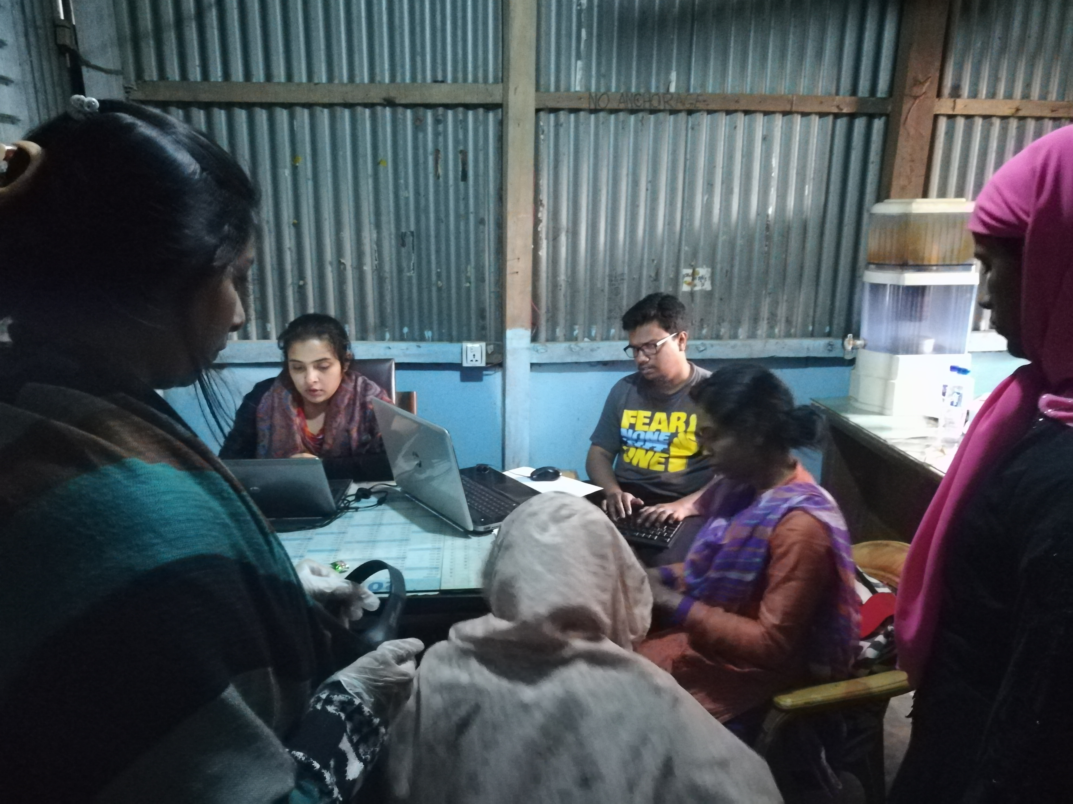

Research Guidance
Rapport
Diversity
Language Barrier
Gender Participation
https://uniontestprep.com/cna/blog/patient-differences-religious-ethnic-and-cultural
Background
Intro
EEG
MINI
EEG+MINI
Reco
Future
Guidance
36
36
36
Structure
36
Notes:
Research advice: cultural diversity must be taken into account. Regugees sometimes have different language than the native. We had someone fluent in a dialect close to theirs. Females are

Slide 37
Summary
A low-cost, fast and flexible system for identifying PTSD-related EEG signals
Validated by pilot study with Rohingya refugees.
Findings are largely in agreement with the prior research.
Bayesian network to understand PTSD symptoms.
Opening the door towards detecting PTSD with wearable device only.
Notes:
Research advice: cultural diversity must be taken into account. Regugees sometimes have different language than the native. We had someone fluent in a dialect close to theirs. Females are

Slide 38
Two Tell-tale Perspectives of PTSD: Neurobiological Abnormalities and Bayesian Regulatory Network of the Underlying Disorder in a Refugee Context
Wasifur Rahman
Farhana Shahid, , Anika Binte Islam, Nipi Paul, Nabila Khan, Mohammad Saifur Rahman, Md Munirul Haque, and A. B. M. Alim Al Islam
38

Slide 39
References
https://www.huffingtonpost.co.uk/entry/rohingya-crisis-photos_n_5a3bc302e4b025f99e150f1d?guccounter=1
https://en.wikipedia.org/wiki/Myanmar#/media/File:Myanmar_-_Location_Map_(2013)_-_MMR_-_UNOCHA.svg
https://www.bbc.co.uk/news/uk-politics-27295412
https://www.legal-malta.com/news/dangers-of-acquiring-citizenship-by-investment
https://www.bbc.co.uk/news/world-11108059
https://www.aljazeera.com/indepth/features/2017/08/rohingya-muslims-170831065142812.html
https://www.japantimes.co.jp/news/2018/04/17/asia-pacific/social-issues-asia-pacific/conditions-worsening-700000-rohingya-refugees-coxs-bazar-ahead-monsoon-rains/#.XXURbZNKjMU

